Slide 1
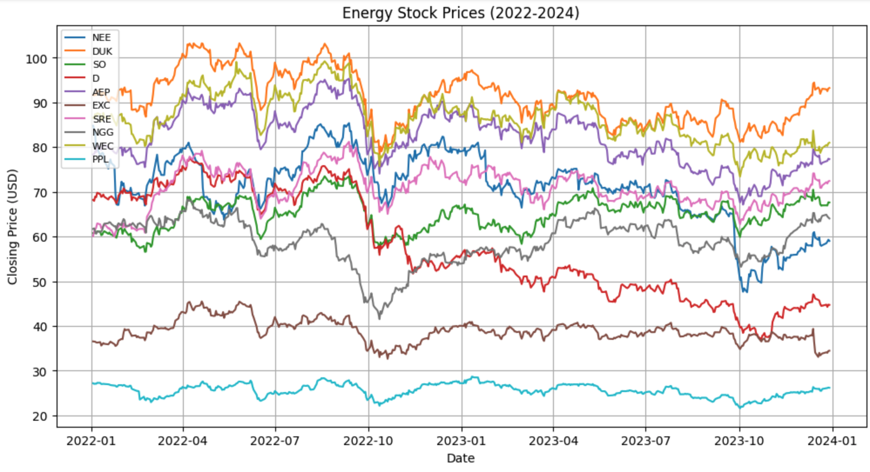
Mean-Reverting Pairs Trading
Nathan Li

Slide 2
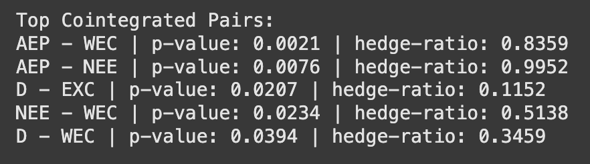
Overview
Testing for Cointegration
Goal: Identify pairs of energy stocks that are cointegrated, and then implement a mean-reverting strategy
Ordinary Least Squares regression of one times series on another
Apply Augmented Dickey Fuller test to residuals
Stationary residuals show cointegration

Slide 3

Trading Strategy
Goal: Trade mean reversion when spread deviates from it’s mean.
Assume that if the spread deviates significantly, it will revert to the mean.
Compute the spread using the hedge ratio
Calculate the mean and standard deviation of the spread
Z > 2: Short the spread
Z < 2: Long the spread
Z = 0: Close position

Slide 4
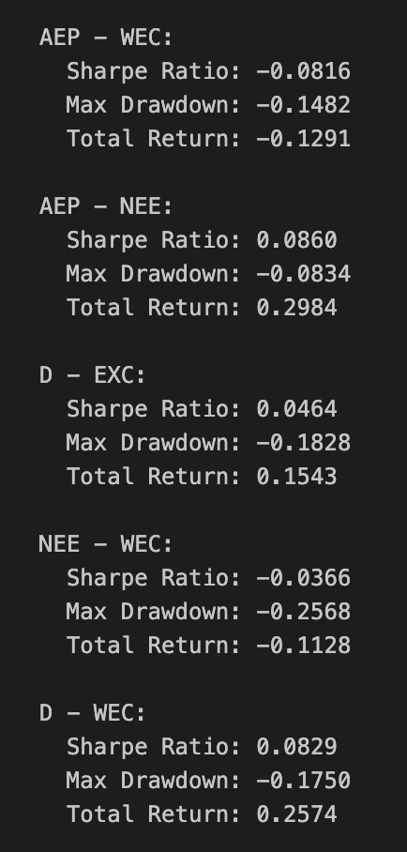
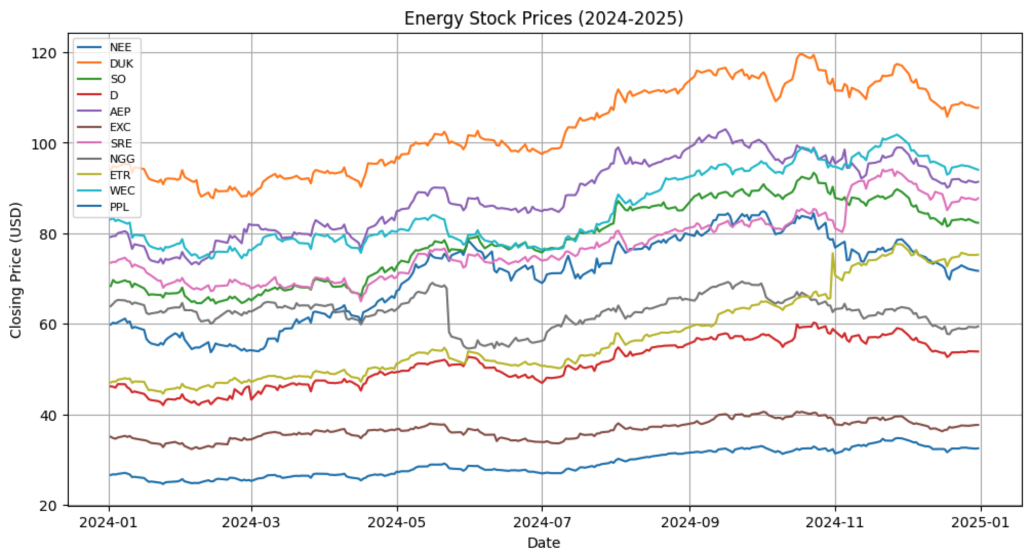
Results
Sharpe Ratio:
Low, even on positions with a high return rate, indicating high risk
Energy Industry return: 0.044
Strategy average return: 0.094

